Slide 1

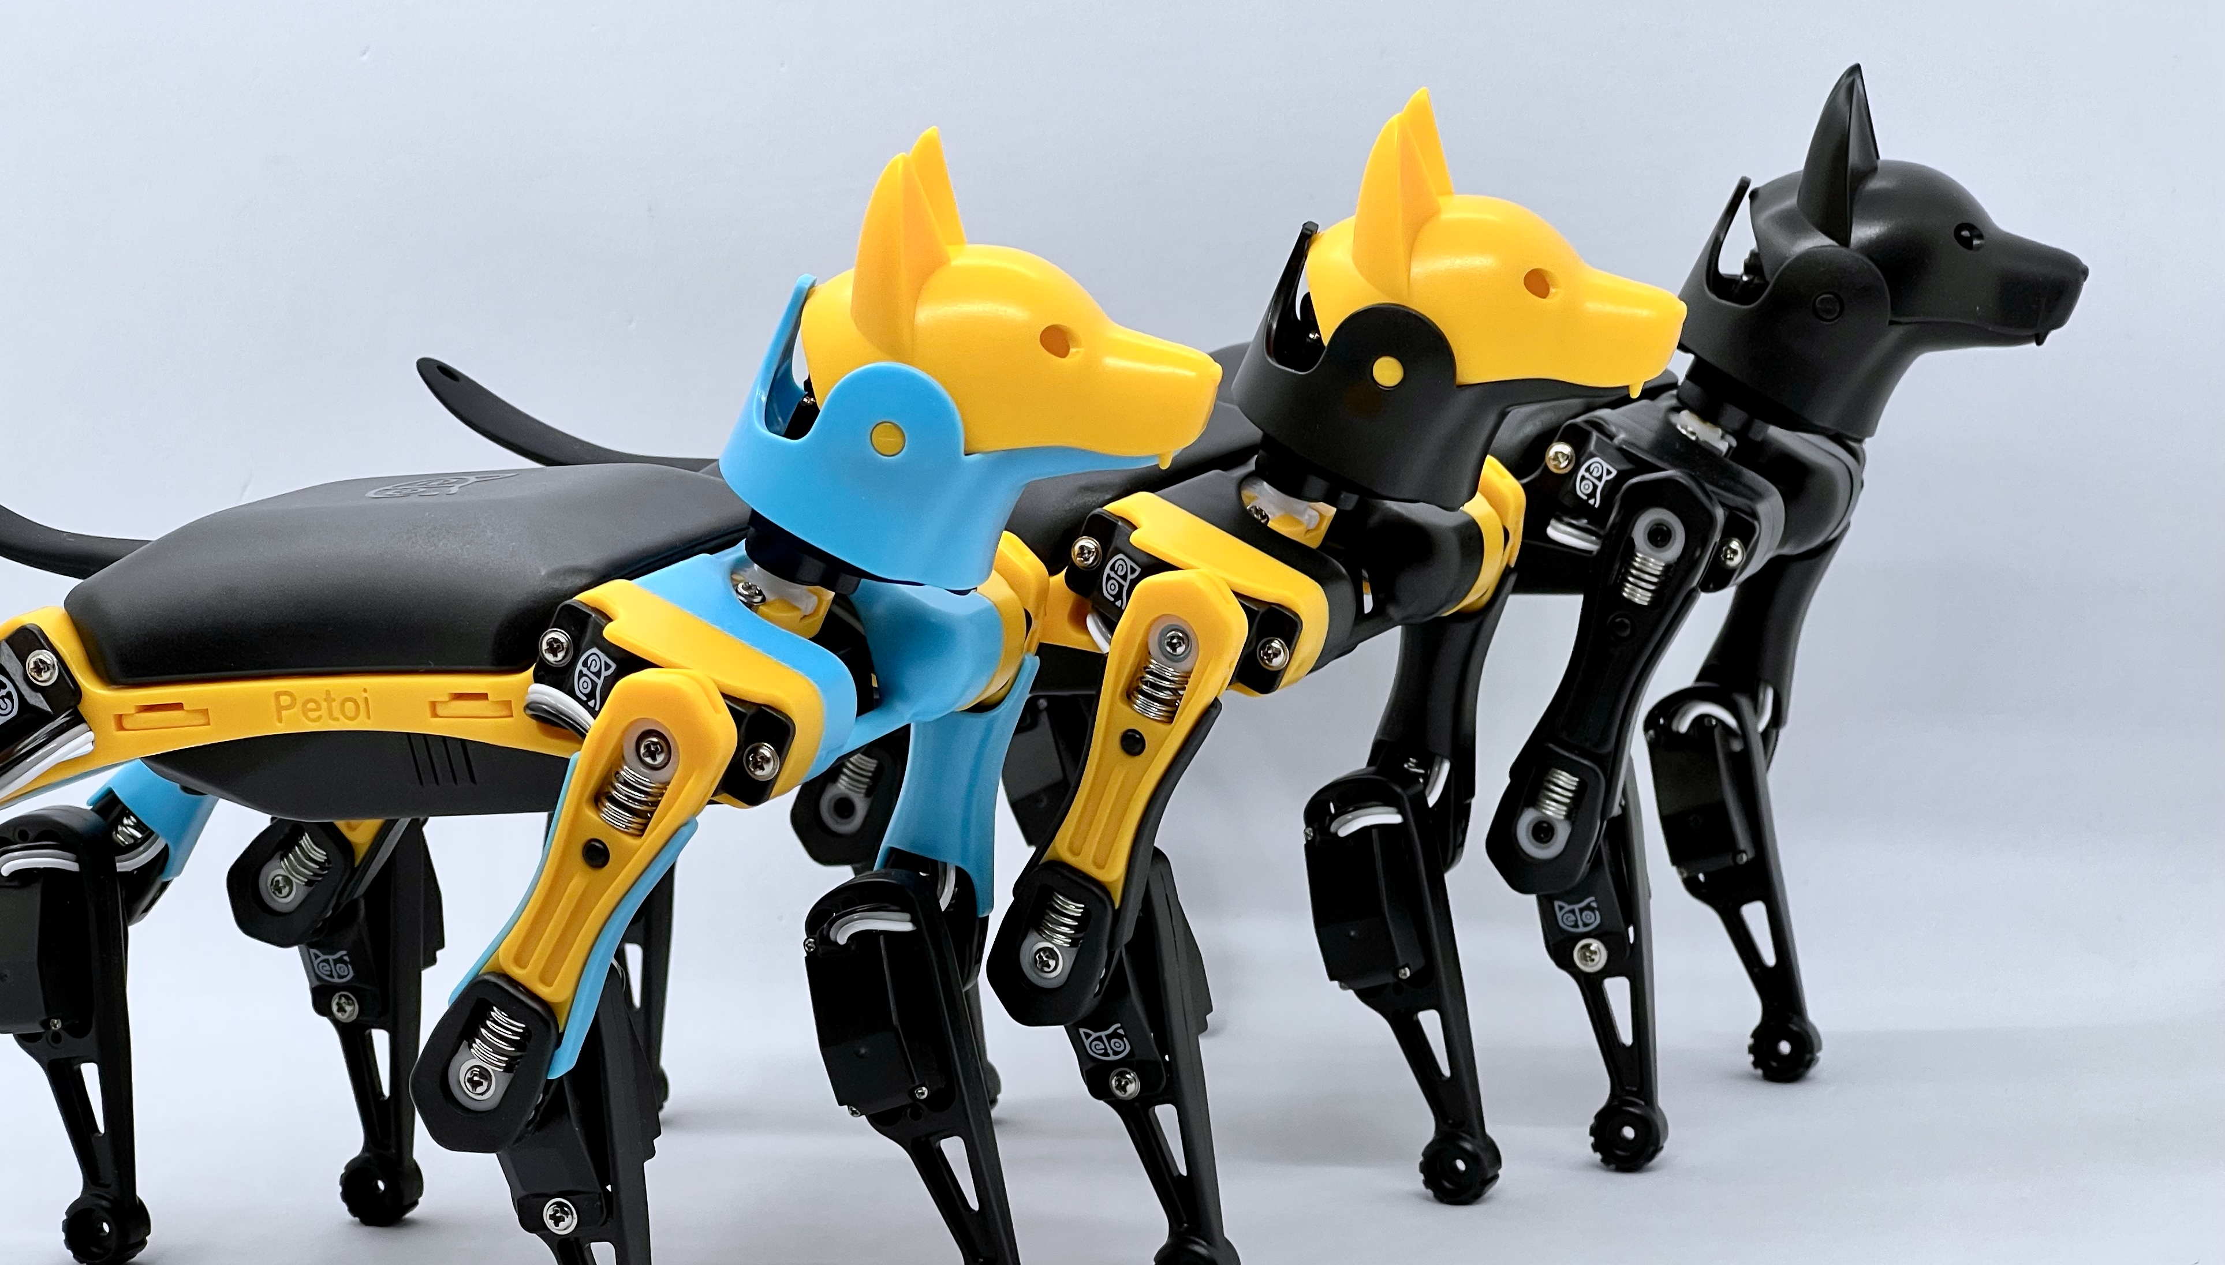

Kia Robo Dog
- you can only see virtually
Petoi Bittle Robot Dog
- you can actually pet & program

